Slide 1
Songkran festival
Thailand

Slide 2
New year
The word songkran means astrological passage.
The Thai people celebrate songkran by spraying water at each other.
It’s the new year for the whole of Thailand.
Lasts from 13 of April to the 15th.

Slide 3
resolutions
It is also celebrated as a Buddhist festival may also go to a wat which is a buddhist monestery to pray and give food to monks.
Some people make new year resolutions to refrain from bad behaviour , or do good things. My new year resolutions are having fun.
Songkran is a time for cleaning and renewal.

Slide 4
Astrological calculation
Songkran is also celebrated in many places with a pageant in which young women demonstrate their beauty and unique talents.
The date of the new year was calculated on a solar basis.
The term songkram means a move or change. In this case the move of the sun into aries.

Slide 5
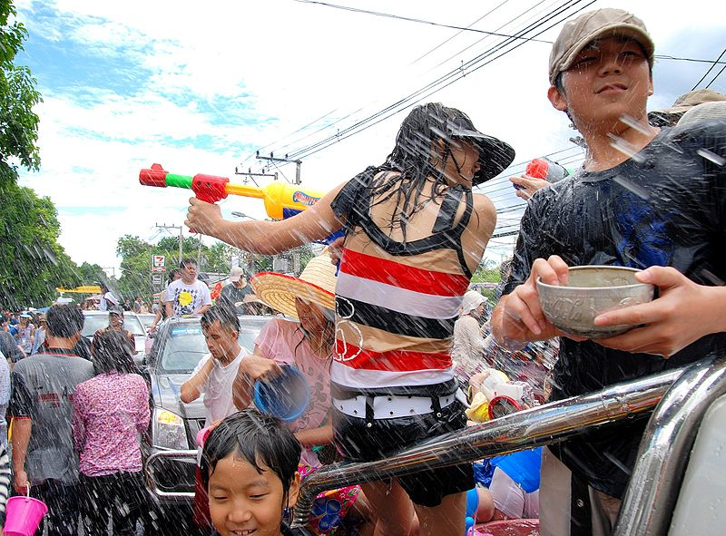
Water Fight!!!!
Sawatdi pi mai ( Happy New Year!!!!!)

Slide 9
Bye!!!!!!

